Slide 1
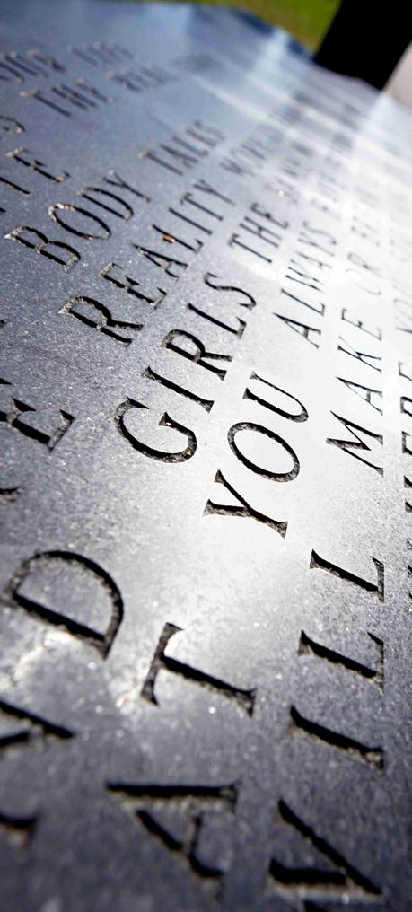
Adaptive Video Games
Jon Vegard Jansen and Robin Tollisen
Supervisor: Sondre Glimsdal
Notes:
Aak Oop Chi

Slide 2

Agenda
Background and Motivation
Problem Statement
Stochastic Hill Climbing
Game
Our Algorithm
Testing
Discussion and Conclusion
Future Work
Notes:
Tor-Erik
Robin has programmed, the rest has written.
Robin secretary.
Worked with Org432 report.

Slide 3
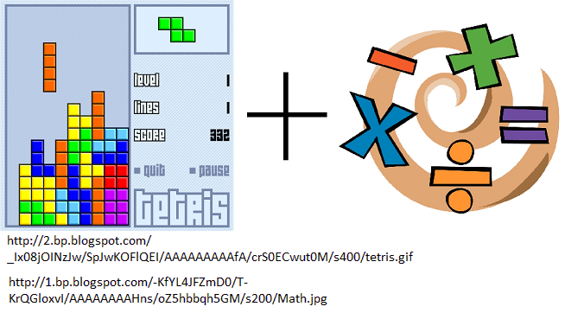
Background and Motivation
E-Learning
Video games
Maximize fun
Notes:
Tor-Erik
Robin has programmed, the rest has written.
Robin secretary.
Worked with Org432 report.

Slide 4
Problem Statement
“... research whether it is possible to create a game, that uses an
unsupervised online learning algorithm, which will adapt the game to the user's
preferences based on limited user feedback.”
Notes:
Tor-Erik
Robin has programmed, the rest has written.
Robin secretary.
Worked with Org432 report.

Slide 5
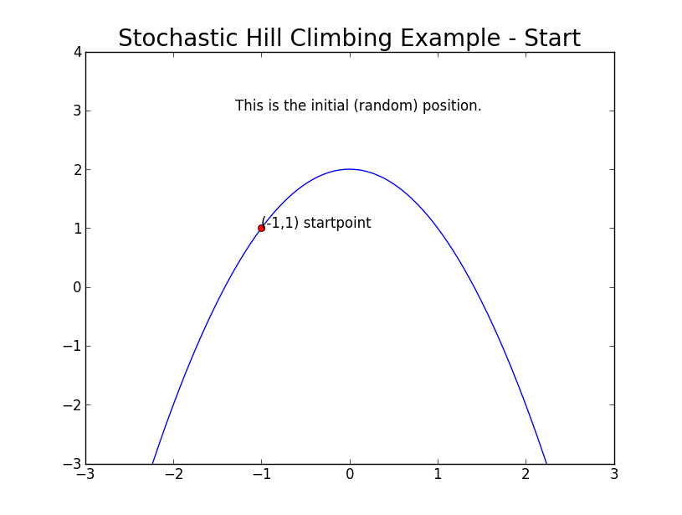
Stochastic Hill Climbing
Notes:
Tor-Erik
Robin has programmed, the rest has written.
Robin secretary.
Worked with Org432 report.

Slide 6
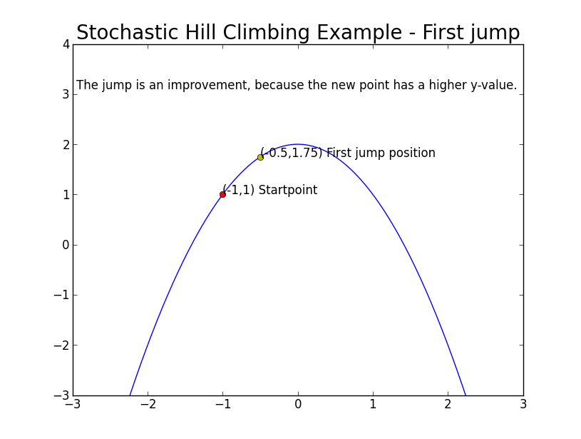
Stochastic Hill Climbing
Notes:
Tor-Erik
Robin has programmed, the rest has written.
Robin secretary.
Worked with Org432 report.

Slide 7
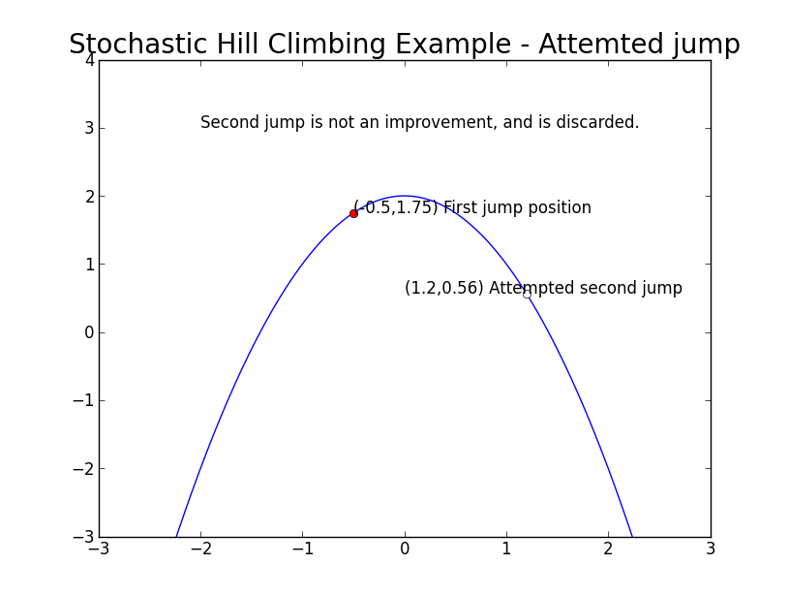
Stochastic Hill Climbing
Notes:
Tor-Erik
Robin has programmed, the rest has written.
Robin secretary.
Worked with Org432 report.

Slide 8
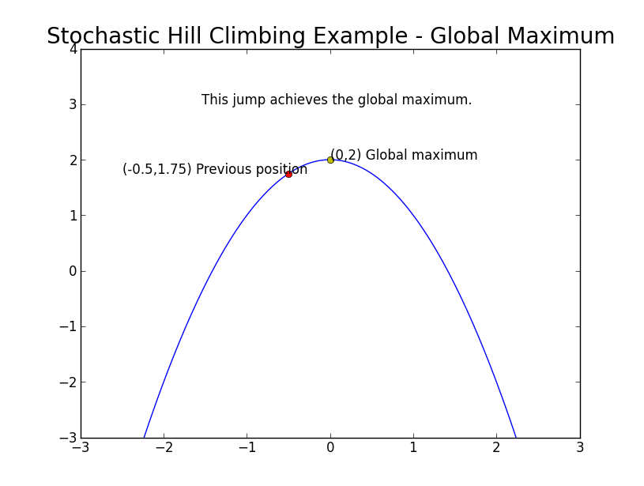
Stochastic Hill Climbing
Notes:
Tor-Erik
Robin has programmed, the rest has written.
Robin secretary.
Worked with Org432 report.

Slide 9
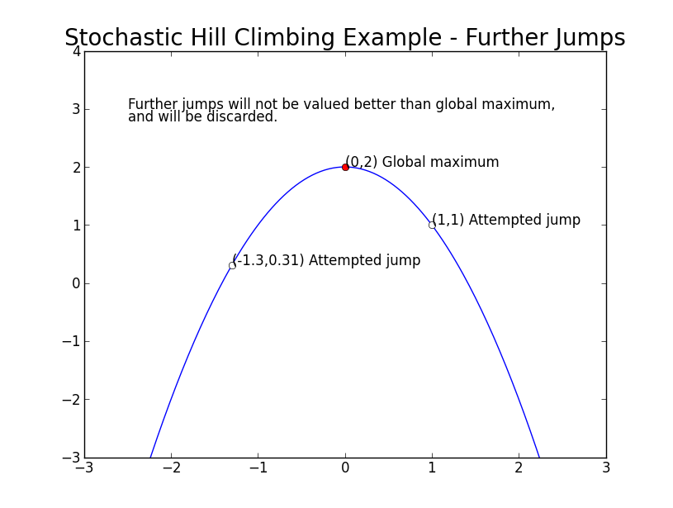
Stochastic Hill Climbing
Notes:
Tor-Erik
Robin has programmed, the rest has written.
Robin secretary.
Worked with Org432 report.

Slide 10
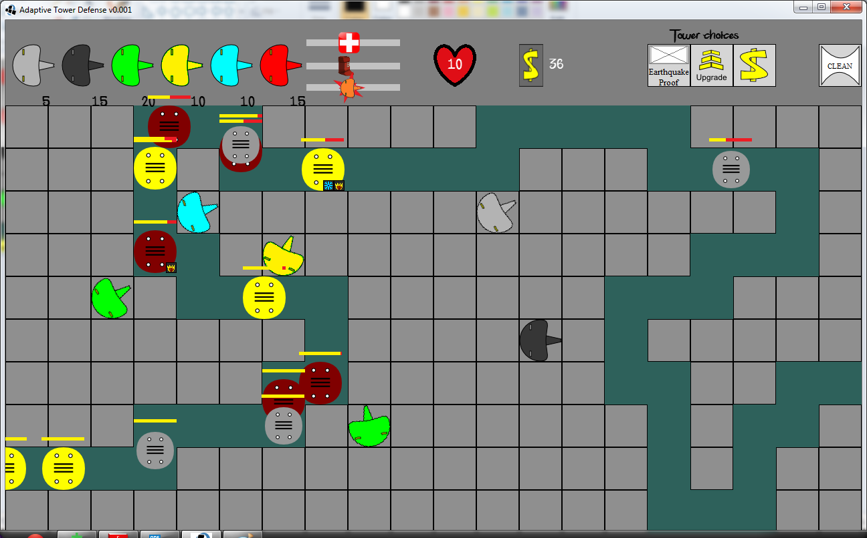
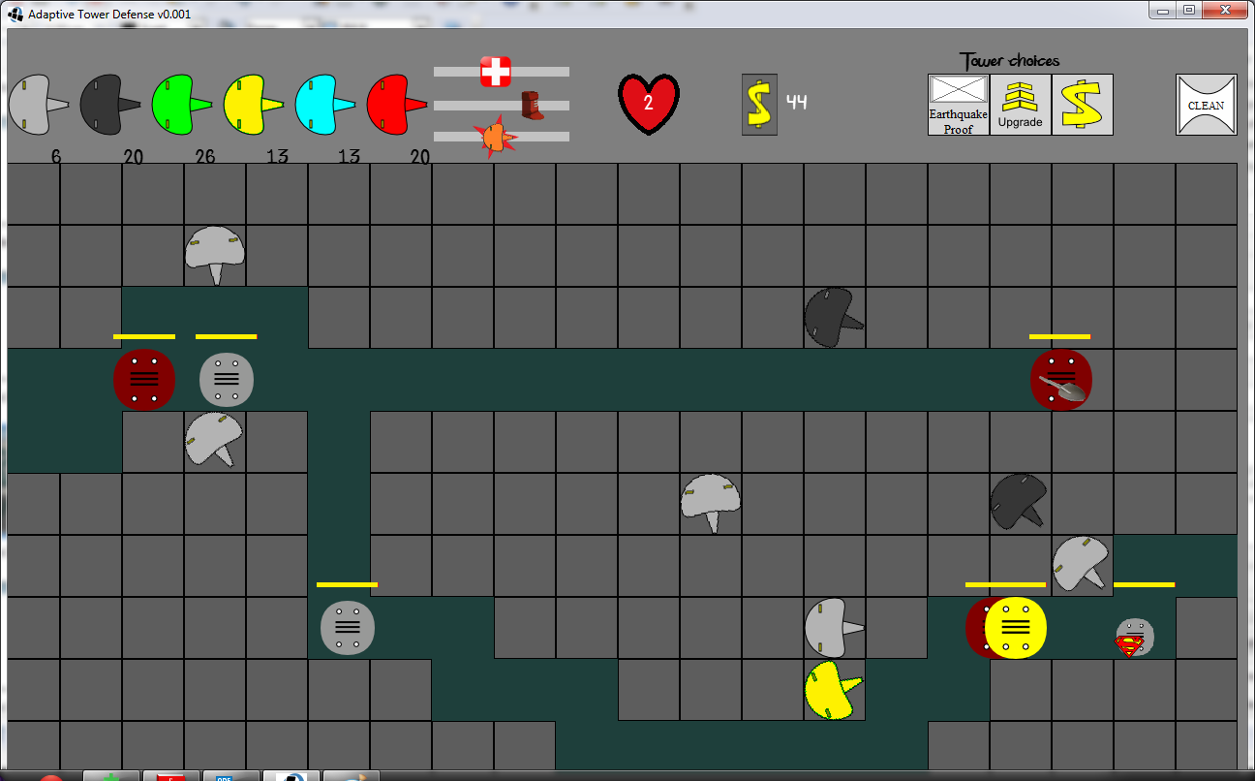
Game
Proof of Concept
  Visual effects
  Underlying parameters
Tower defense
Adaptive Tower Defense by Jon Vegard Jansen and Robin Tollisen, UiA Grimstad
Notes:
Chichichi

Slide 11
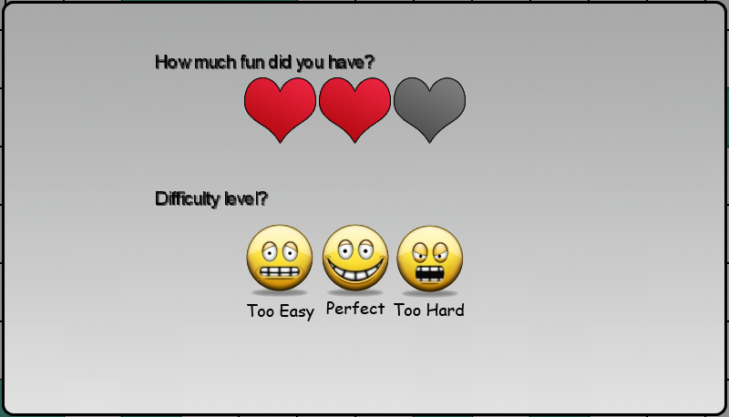
Our Algorithm
Notes:
Tor-Erik
Robin has programmed, the rest has written.
Robin secretary.
Worked with Org432 report.

Slide 12
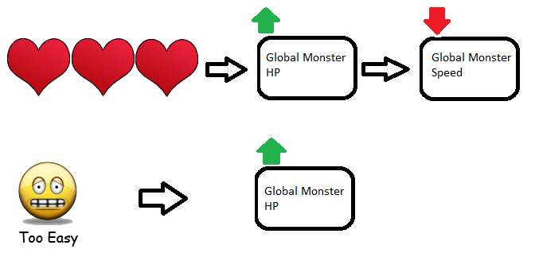
Our Algorithm
Our modified version
  List of parameters
  Relations to maintain balance
Notes:
Tor-Erik
Robin has programmed, the rest has written.
Robin secretary.
Worked with Org432 report.

Slide 13
Testing
Measuring fun
Mixed feedback
  Friends
  Case tests
Adaptive Tower Defense by Jon Vegard Jansen and Robin Tollisen, UiA Grimstad
Notes:
Chichichi

Slide 14

Discussion and Conclusion
Adaptive difficulty: Good
Multiple specialized algorithms
  Automatically detect user preferences
Tower defense as adaptive game genre
E-Learning
Notes:
Chichichi

Slide 15

Future Work
Refine algorithm for tower defense
Create E-Learning games, that adapt to user preferences
Notes:
Chichichi

Slide 16
Questions?

